Slide 1
Bank Marketing Campaign
File created on: 10/6/2022 4:36:55 AM

Slide 2
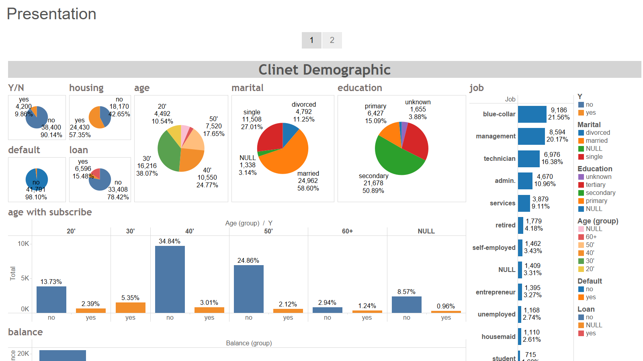

Slide 3
